Slide 1
Walmart Superstore Sales Analysis
Data visualization

Slide 2
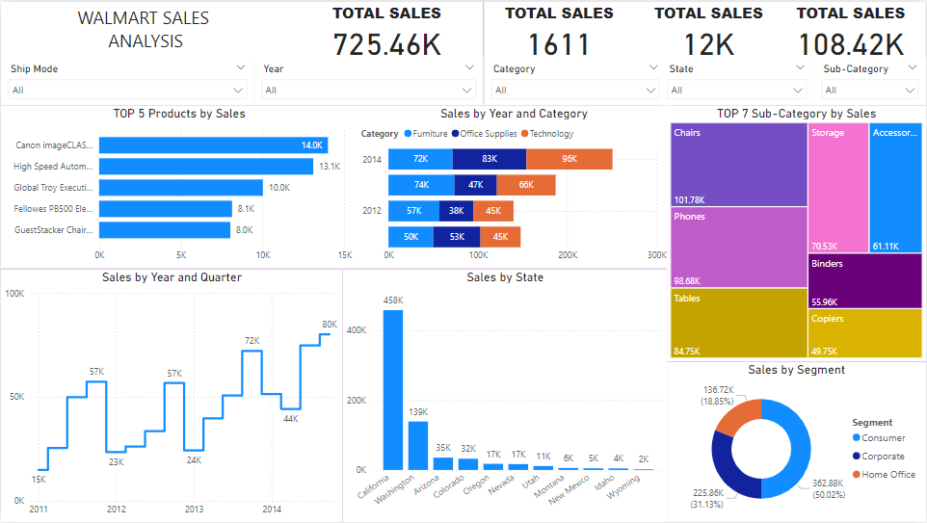
SALES DASHBOARD

Slide 3
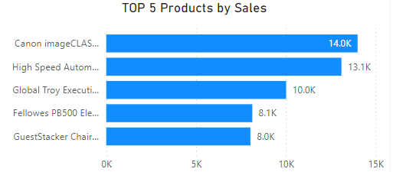
These are the top 5 Selling Products from 2011-2014
Canon image CLASS 2200 Advanced Copier
High Speed Automatic Electric Letter Opener
Global Troy Executive Leather Low-Back Tilter
Fellowes PB500 Electric Punch Plastic Comb Binding Machine with Manual Bind
Guest Stacker Chair with Chrome Finish Legs

Slide 4
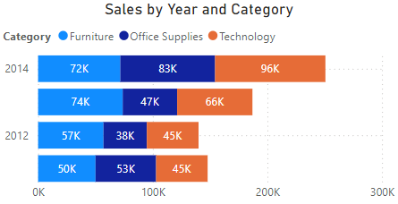
Category performance from 2011-2014
Technology Peaking Up in 2013 & 2014
Office Supplies sudden jump in growth
Furniture increases gradually

Slide 5
Category performance from 2011-2014
Technology Peaking Up in 2013 & 2014
Office Supplies sudden jump in growth
Furniture increases gradually

Slide 6
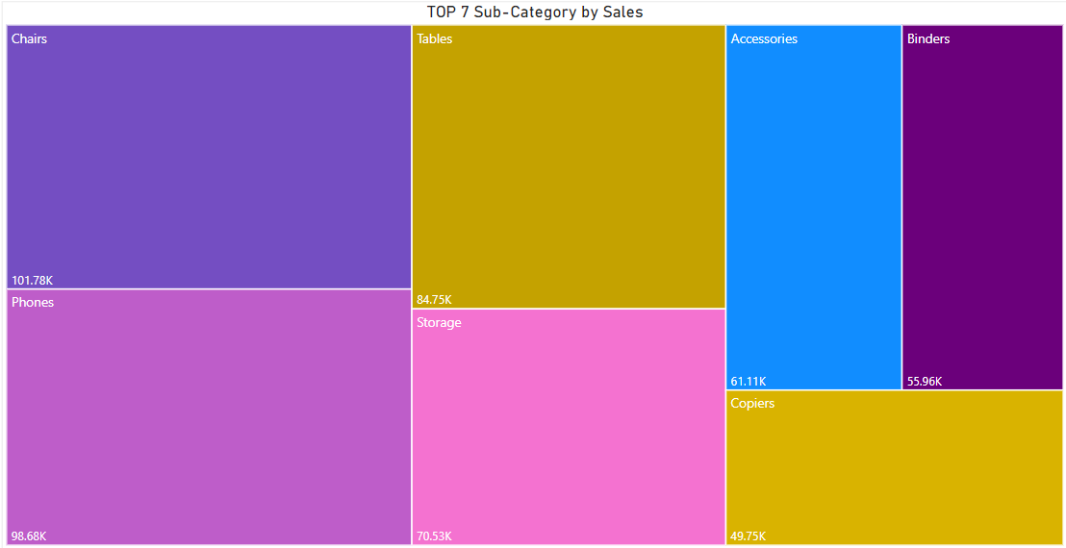
Top 7 Sub-Category performance from 2011-2014
Chairs
Phones
Tables
Storage
Accessories
6. Copies
7. Binders

Slide 7
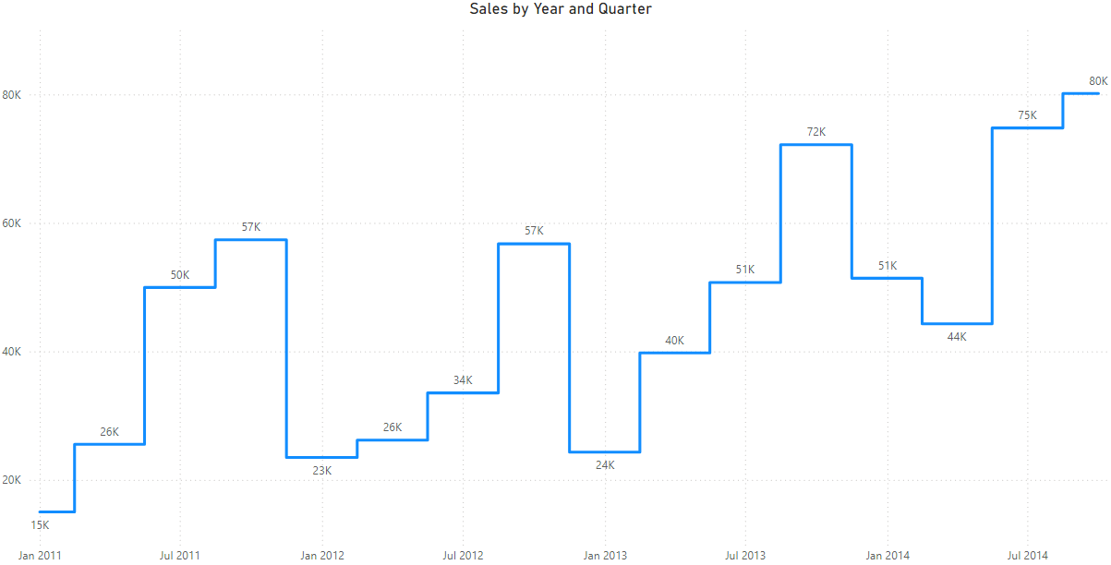
Sales Graph by Year and Quarter (2011-2014)
Overall view shows us that Q1 is slowing down on every year and then gradually sales performances increases in Q2 & Q3. Finally Q4 tops the sales performance in the year end.

Slide 8
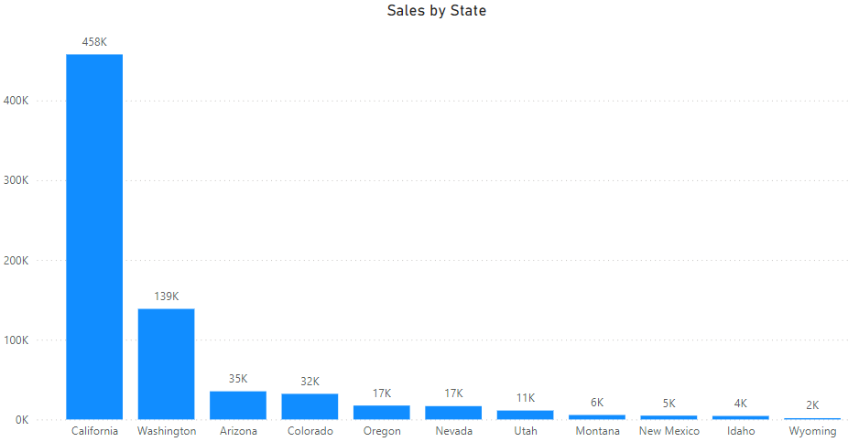
Sales Graph by State(2011-2014)
California ranks first when it comes to sales where spending economy is more followed by Washington, Arizona, Colorado, Nevada, Utah… so on.

Slide 9
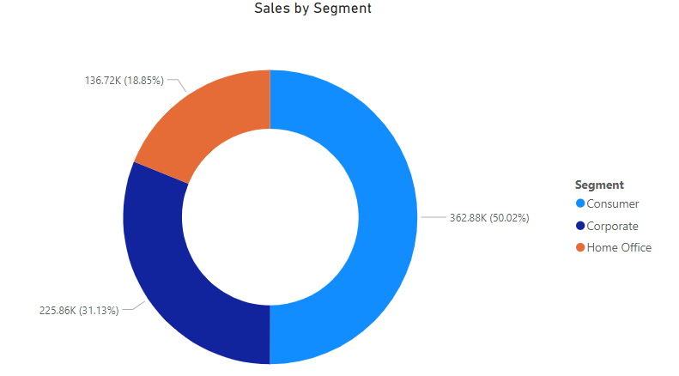
Sales Chart by Segment (2011-2014)
Walmart was performed well in between three standards of costumers when it comes sales and revenue.
Consumer
Corporate
Home Office

Slide 10
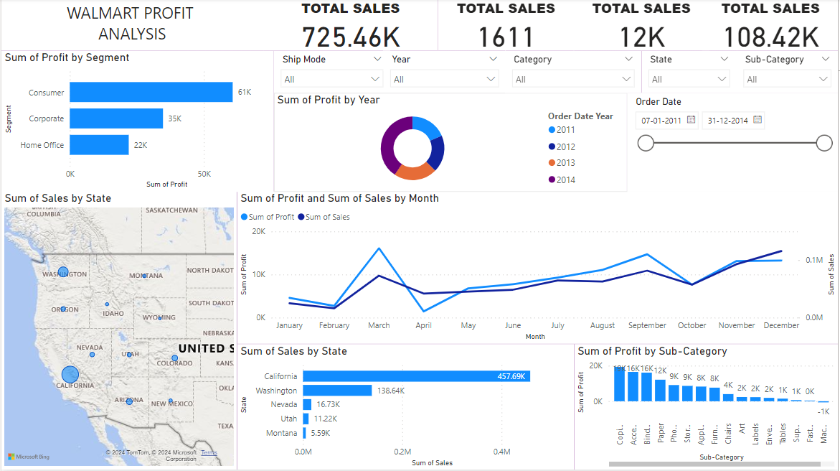
PROFIT DASHBOARD

Slide 11
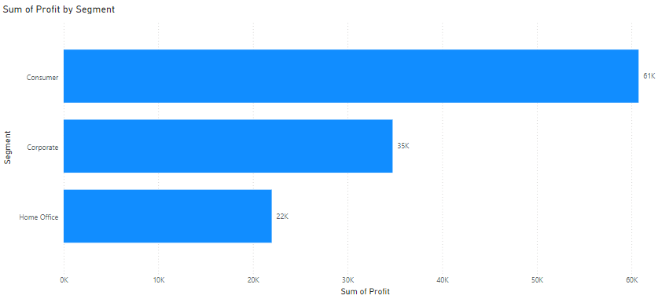
Profit by Segment Analysis
Consumer
Corporate
Home Office

Slide 12
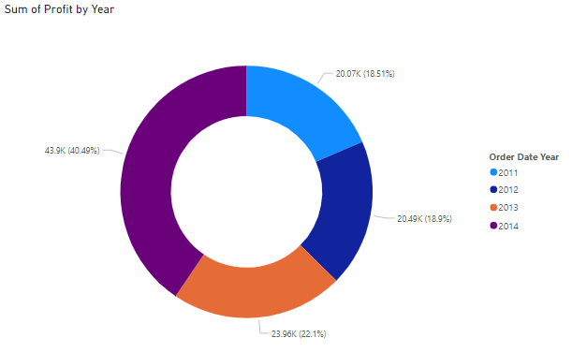
Sum of Profit Year based Analysis

Slide 13
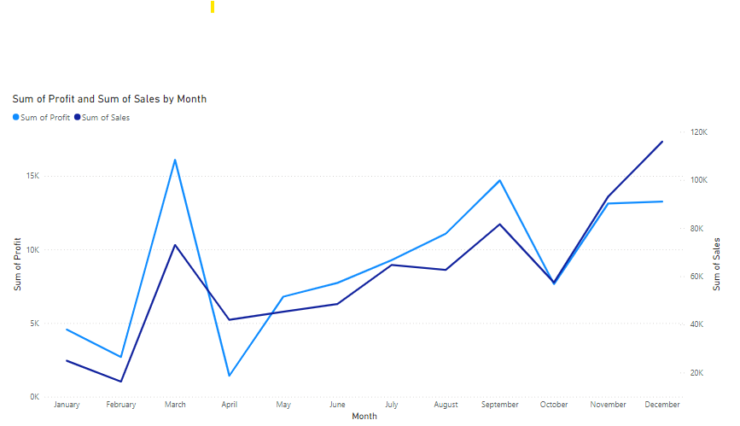
Sum of Profit and Sum of Sales by month Analysis, March month generates huge amount of profit
where there is huge dip on the next month April.

Slide 14
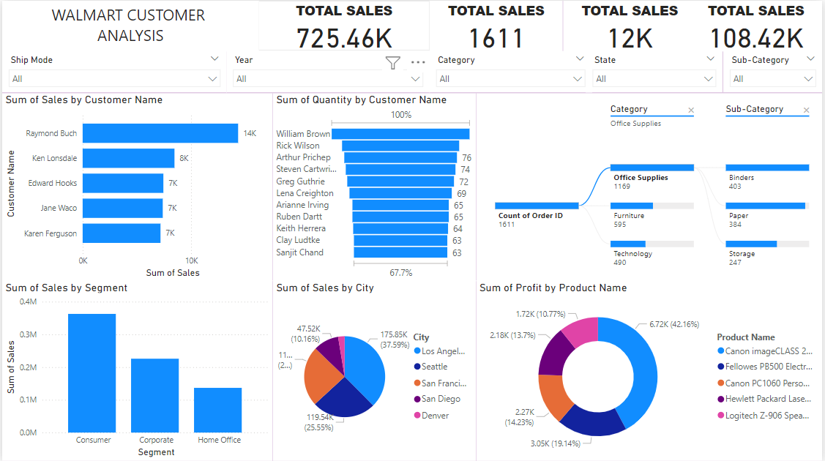
CUSTOMER ANALYSIS

Slide 15
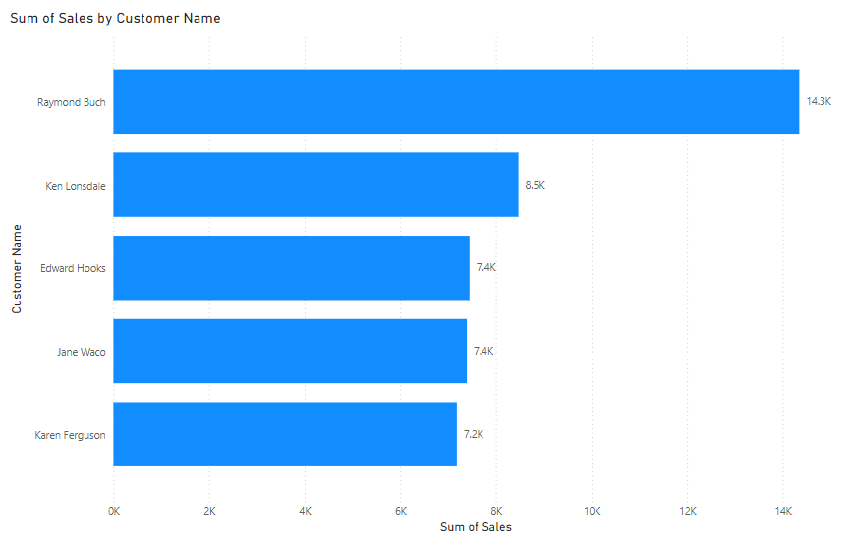
Top 5 Customers

Slide 16
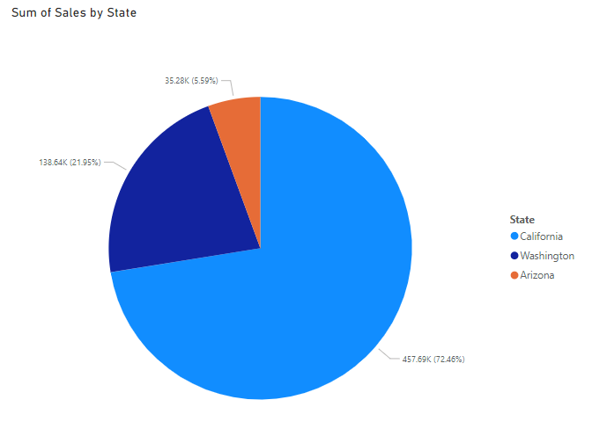
Most Spending Costumers percentage from these 3 States

Slide 17
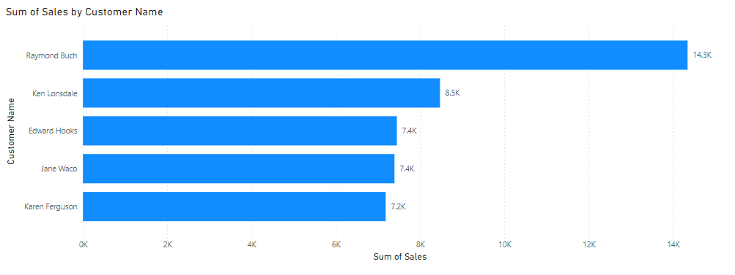
Top 5 Purchasing Customers

Slide 18
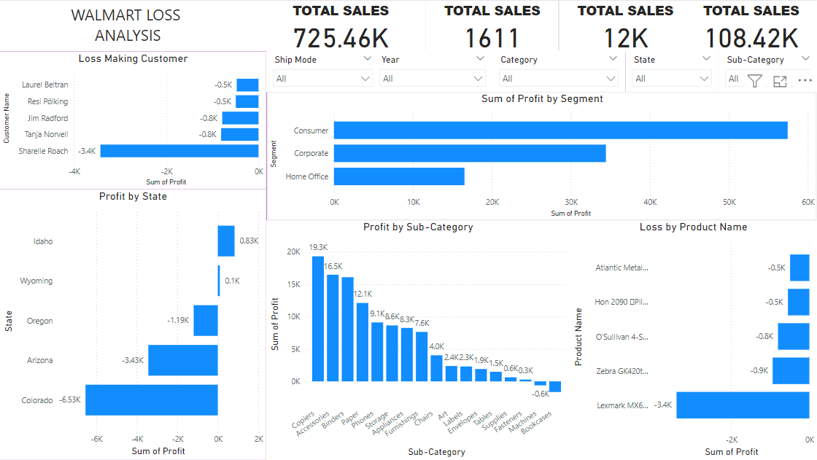
LOSS ANALYSIS

Slide 19
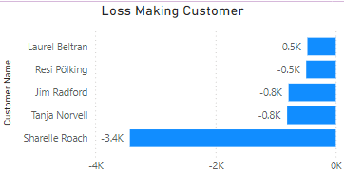
As per the data, need to checkout with Customers in order to fulfil their expectation.

Slide 20
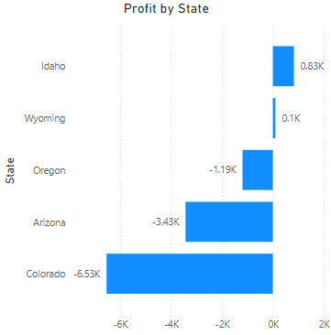
State wise Analysis show us need to work in some states where there is severe negative imprint with customer.

Slide 21
State wise Analysis show us need to work in some states where there is severe negative imprint with customer.

Slide 22
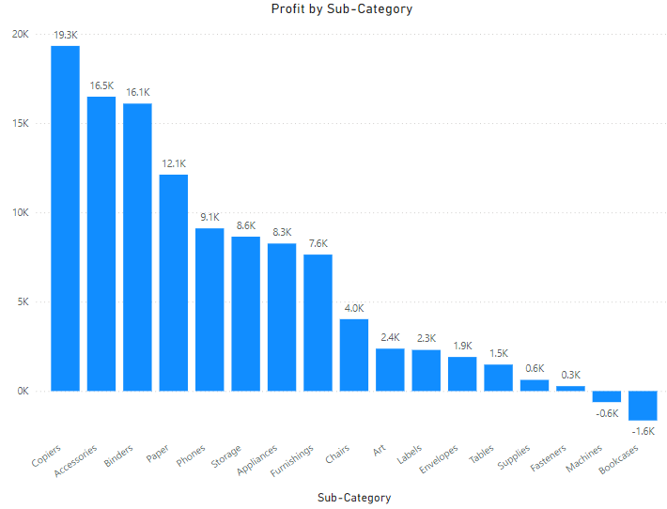
Sub-Category Analysis, Copiers tops in terms of profit whereas Machines and Bookcases making
negative impact in revenue.

Slide 23
THANK YOU
By Leon R
MBT7

